Slide 1
GIT Workshop
Source Control for Everyone

Slide 2

Durandal.js: Get Started
Michael Dudley
Pluralsight
http://provenstyle.com/

Slide 3


Slide 4
http://DallasTechFest.com
@DallasTechFest

Slide 5
Who Are We?
Tim Rayburn
Principal Consultant with Improving
Microsoft MVP for Connected Systems Development
Student of GIT, and many other things
Finalist in the Dominion U.S. Qualifiers
Oh, and apparently, I’m a GIT
@Trayburn
Tim.Rayburn@
ImprovingEnterprises.com

Slide 6
Who Are We?
Cori Drew
Consultant with Improving
Madly in love with C#
Hater of Whiners (but not Winers)
“Just Do GIT”
@CoriDrew
Cori.Drew@
ImprovingEnterprises.com

Slide 7
Agenda
GIT On Your Box
Starting Locally
The Basics
Branching & Merging
Wait, Go Back!
To Infinity And Beyond
Starting from a Remote
Sending To A Remote
Branches Elsewhere

Slide 8
Installing GIT

Slide 9
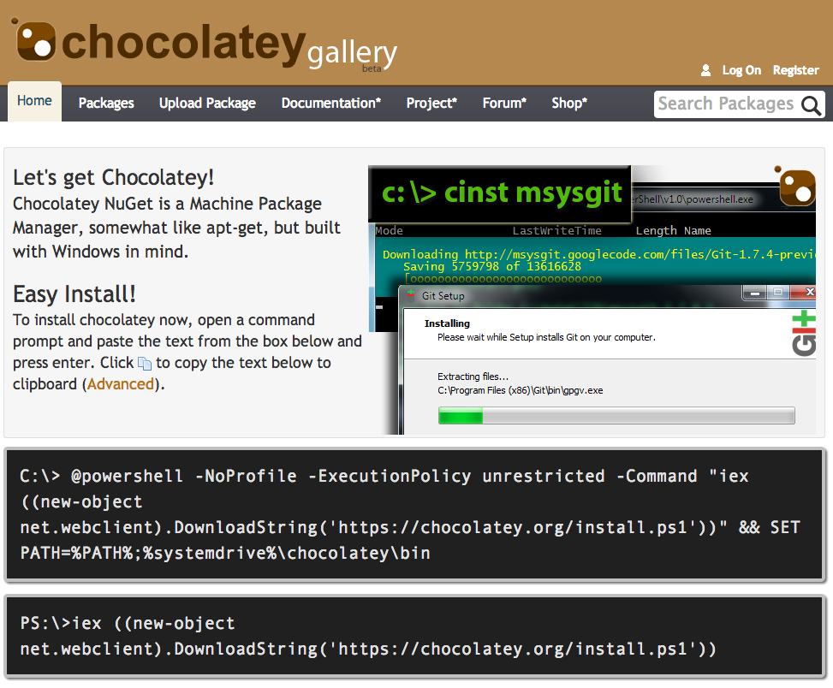
Chocolatey.org
# You don’t have to use Chocolatey
# But why wouldn’t you?
# Installs BOTH Bash & PowerShell
cinst poshgit
# My Personal Aliases
cinst TimRayburn.GitAliases

Slide 10
What is DVCS?
GIT On Your Box

Slide 11
VCS
TFS
Tim
Cori
David
Jeff

Slide 12
VCS
Master
Slave
Slave
Slave
Slave

Slide 13
DVCS
The Server
Cori
Tim
Jeff
David

Slide 14
DVCS
The Server
Cori
Tim
Jeff
David

Slide 15
Starting Locally
GIT On Your Box

Slide 16
The Basics
GIT On Your Box

Slide 17
Setting things up…
Request New Workspace
Go out to lunch
Check and see its still not there
Send the admin another email
Check Facebook
Check again, nope still not there
Call the Admin, find out he’s on vacation
Call the Backup Admin
Wait for him to finish his game of solitaire
Find out he spelled it wrong
Ask for the spelling to be corrected
Go home, still with no Workspace
Get an email from the Primary saying it already exists
Map the new workspace to a local directory
FINALLY commit some code to the Workspace

Slide 18
Setting things up…
Create a Directory
Change to that Directory
git init

Slide 19
Creating a local repository
mkdir c:\source\deleteme
cd c:\source\deleteme
git init
Notes:
This brings in my default set of aliases, and adds them to the global configuration.

Slide 20
Writing Code Workflow
Write Code
Commit
Add Files

Slide 21
Writing Code Workflow
# Assuming you’ve written code already
# From the root of your repository
git add .
git commit -m "<commit message>"
Notes:
This brings in my default set of aliases, and adds them to the global configuration.

Slide 22
Writing Code Workflow
Write Code
git commit -am “<msg>”
git add .

Slide 23
How it works…
Working Directory
Holds Your Files
Can be freely edited, no locks!
Index
Contains files to be included in the next commit
“git add” puts files in the index
Local Repository
Your history
The most recent commit is called HEAD
“git commit” creates a commit, which is then HEAD
“git init” turns any directory into a new repository

Slide 24
The Extras
# Check the state of your directory
git status
# Check your commit history
git log --oneline

Slide 25
Branching & Merging
GIT on Your Box

Slide 26
Working with Branches
# Your first branch is always master
# Creating another branch is easy
git checkout -b <name>
# To change branches
git checkout <name>

Slide 27
Working with Branches
# To merge one branch to another
git checkout <destination>
git merge <source>

Slide 28

Pay Attention!
GIT branches are all in
the same directory.
When you change branch,
the files are changed to
match that branch.

Slide 29
Branch per Feature Workflow
Branches are cheap and easy
So create & destroy them often
Don’t use master, branch to working
(I’ll explain why later)

Slide 30
Branch per Feature Workflow
Create a feature branch
Change back to working
Loop the Write Code Workflow
Merge in your changes

Slide 31
Branch per Feature Workflow
git checkout -b <feature>
git checkout working
Loop the Write Code Workflow
git merge <feature>

Slide 32
The Extras
# List all your branches
git branch
# This only works with Tim’s aliases:
# View log across all branches
git lga

Slide 33
The Extras
# Delete a branch you don’t need
git branch -D <name>

Slide 34
Wait! Go back!
GIT on your box

Slide 35


Slide 36
Remember Your Extras
# Check the state of your working
# directory and index
git status
# View log across all branches
git lga

Slide 37
Committed the wrong thing?
# To roll back a commit,
# and keep your changes
git reset HEAD~1

Slide 38
Tried something that didn’t work?
# Permanently destroy your
# uncommitted work?
git reset --hard HEAD
# Use with care, uncommitted
# means unrecoverable

Slide 39
Questions & Answers
GIT on your box

Slide 40
Starting from a Remote
To Infinity and Beyond

Slide 41
Clone a repository
# If someone else has already
# created a repository, then
# your start by cloning it
git clone <address> <directory>
# Puts the directory in your current
# working directory.

Slide 42
How it works…
Working Directory
Holds Your Files
Can be freely edited, no locks!
Index
Contains files to be included in the next commit
“git add” puts files in the index
Local Repository
Your history
The most recent commit is called HEAD
“git commit” creates a commit, which is then HEAD
“git init” turns any directory into a new repository

Slide 43
How it works…
Working Directory
Holds Your Files
Can be freely edited, no locks!
Index
Contains files to be included in the next commit
“git add” puts files in the index
Local Repository
Your history
The most recent commit is called HEAD
“git commit” creates a commit, which is then HEAD
Remote Repository
Contains the shared history of all committers
“git clone” copies it repository
“git push” sends local to remote
“git pull” brings remote changes to local
“git init” turns any directory into a new repository

Slide 44


Where can I find a remote?

Slide 45
Remotes
To Infinity and Beyond

Slide 46
Tim
Cori
Server
Jeff
David

Slide 47
Tim
git remote add cori <path>
Cori
Server
Jeff
David

Slide 48
Tim
git remote add cori <path>
Cori
Server
Jeff
git remote add drew <path>
David

Slide 49
Tim
git remote add cori <path>
git remote add sharpie <path>
Cori
Server
Jeff
git remote add drew <path>
git remote add sharpie <path>
David

Slide 50
Tim
git remote add cori <path>
git remote add sharpie <path>
ORIGIN
Cori
Server
Jeff
ORIGIN
ORIGIN
ORIGIN
git remote add drew <path>
git remote add sharpie <path>
David

Slide 51
Sending to a Remote
To Infinity and Beyond

Slide 52
Send changes to a remote
# Send your local commits to
# the remote repository
git push <remote> <branch>
# Pushes your changes to a remote
# branch of the same name

Slide 53
Branches Elsewhere
To Infinity and Beyond

Slide 54
Get changes from a remote
git pull <remote> <branch>
# If merge conflicts exist:
git mergetool

Slide 55

Beyond Compare
The best, in my opinion, merge tool for GIT.
Available for Windows, Mac and Linux

Slide 56
Agenda
GIT On Your Box
Starting Locally
The Basics
Branching & Merging
Wait, Go Back!
To Infinity And Beyond
Starting from a Remote
Sending To A Remote
Branches Elsewhere

Slide 57
GIT Cheat Sheet
http://ndpsoftware.com/git-cheatsheet.html

Slide 58
Slides & Code
http://github.com/trayburn/Presentation-GitIntro

